Slide 1

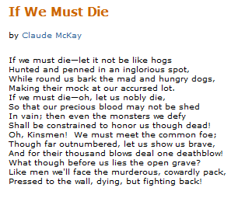
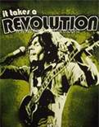
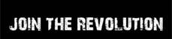
The Struggle for in the box and out the box changed:
Movement militants wanted a new box

Slide 2
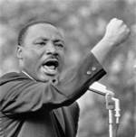
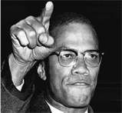
Five ideological
currents
Pan-Africanism
Nationalism
Black Liberation Theology
Feminism/Womanism
Socialism

Slide 3
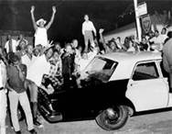
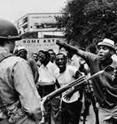
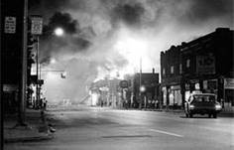
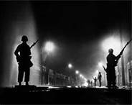
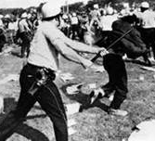
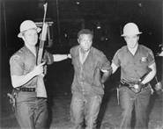
Insurrection changed everything
Watts 1964
Detroit 1967
Newark 1967

Slide 4
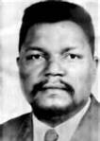


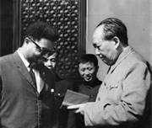
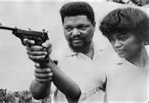
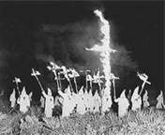
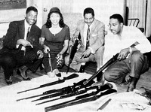
Robert Williams (1925-1996)

Slide 5

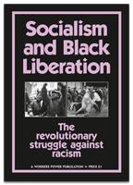
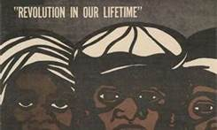
Search for a vanguard spread
throughout the community
Students
Workers
Street
Revolutionaries
Pan-Africanists

Slide 6
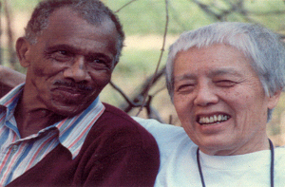
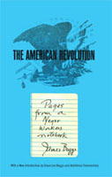

The Street Force: The city is the Black
mans land: James Boggs (19189-1993
“These urban rebellions heralded the emergence of a new social force inside the Black community itself, the street force of Black youth. This force is made up of the new generation of Blacks who I the past would have been integrated into the American economy in the traditional Black role of unskilled And menial labor. Now they have been rendered obsolete by the technological revolutions of automation and cybernation and driven into the military, the prisons anda the streets. Outcasts, castaways And castoffs, they are without any future except that which Black Power can create for them.” (1969)

Slide 7
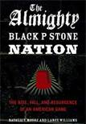
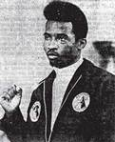
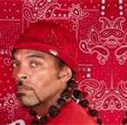

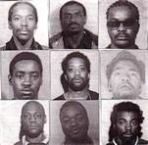
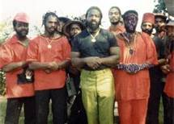
Youth Street Gangs: The answer?

Slide 8
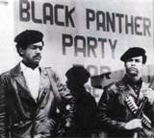
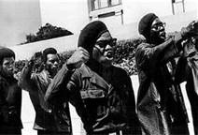
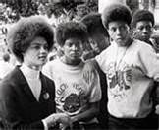
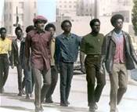
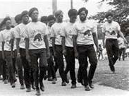
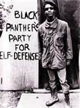
Black Panther Party: Revolutionary
nationalism and the street force

Slide 9
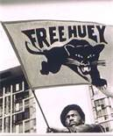

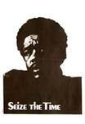
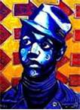
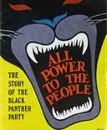
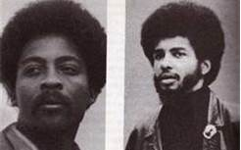
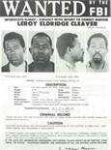
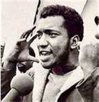
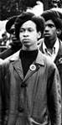
Panthers faced violent repression

Slide 10

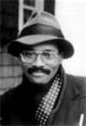
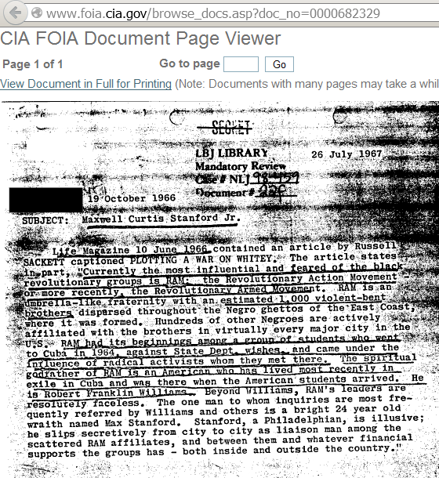
Revolutionary Action Movement (RAM)
“RAM…was the result of the new message of Robert F Williams and Malcolm X, trying to put their insights into practice. From the start RAM aimed at socialist revolution.”
(1962-1968)

Slide 11
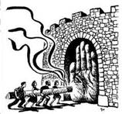
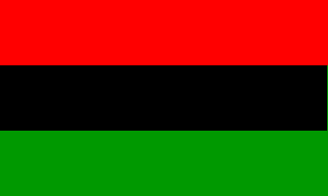
RAM Elected Leadership
Summer 1964
International Spokesman Malcolm X
International Chairman Robert F Williams
National Field Chairman Max Stanford
Executive Chairman Don Freeman
Ideological chairman James Boggs
Executive Secretary Grace Lee Boggs
Treasurer Milton Henry/ Paul Brooks

Slide 12
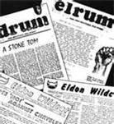
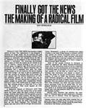

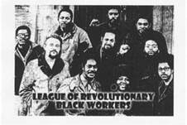
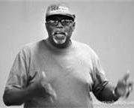
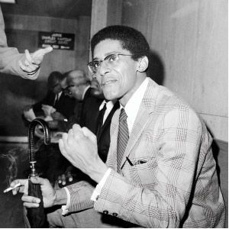

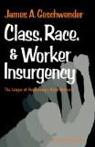
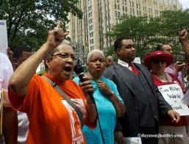


DRUM

Slide 13








LRBW:
League of
Revolutionary
Black Workers
BWC:
Black Workers
Congress

Slide 14











Communist Labor party
Nelson Peery

Slide 15


SOBU:
Student Organization for Black Unity
MXLU:
Malcolm X Liberation
University

Slide 16


FFM: February First Movement
RWL:
Revolutionary Workers League

Slide 17







Pan-Africanists:
African Peoples Socialist party

Slide 18



Pan-Africanists:
African Peoples Revolutionary party
“The job of a revolutionary is, of course, to overthrow unjust systems and replace them with just systems because a revolutionary understands this can only be done by the masses of the people. So, the task of the revolutionary is to organize the masses of the people, given the conditions of the Africans around the world who are disorganized, consequently all my efforts are going to organizing people.”

Slide 19




Pan-Africanists:
New African Peoples Organization

Slide 20







ALSC
African Liberation
Support Committee
A great debate developed in the fight for African Liberation. A revolutionary consciousness became a force in the BLM.

Slide 21
So, what happened?
Greatest fight for a new
box since the 1930’s
2. Greatest advance against
racism sine the Reconstruction
3. Ideological clarity in massive
production of anti-capitalist
literature

Slide 22

But what else happened?
New Deal coalition broken
by racist Southern politicians
2. Neo-fascist movements reborn
3. More Blacks coopted by
capitalist state, bribed
Black leaders murdered
Actually existing Socialism goes
capitalist
What in the world is going on?

Slide 23
Is Revolution possible
because we want it?
NO!
If so, Black people would have been free from day one!
However, the crisis of the capitalist state continues to
turn the 99% against the 1%.
But if the socialist box didn’t work,
do we need a box?

Slide 24

Question:
Is NO BOX Possible
or is that a utopian
dream?

